Slide 1

Project name-RentAPlace
PJ
Project of Team 5
Make by Team 5

Slide 2

About the member
There are 4 people
Nguyen Viet Thang Sap ID: 52020237
Chu Van Quyet Sap ID: 52020317
Sandeep Sap ID: 52023297
Chaithanya Sap ID: 52020105

Slide 3

Content
1. What is our project?
2. What are the functions?
3. What to use?
4. Demo

Slide 4

1. What is our project?
RentAPlace is an online store to rent the home for short and long-time duration
There are 2 users on the application :
1.User
2.Owner

Slide 5
2. What are the functions?
1.User:
+ login, register, log out
+ view the top-rated properties in different categories
+ Find relevant information

Slide 6
2. What are the functions?
2. Owner
+ login, register, log out
+ add properties on the platform
+ update delete and get attributes
+ view user messages and reply

Slide 7
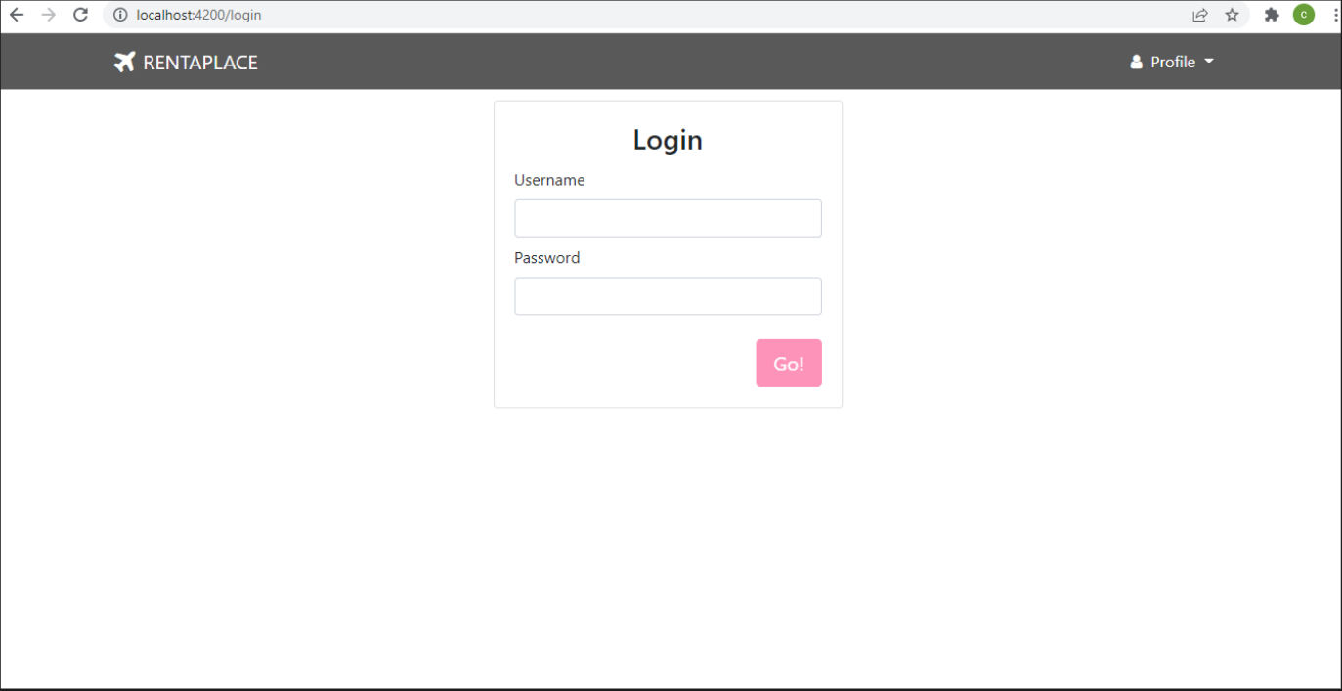
4. Demo
Login page:

Slide 8
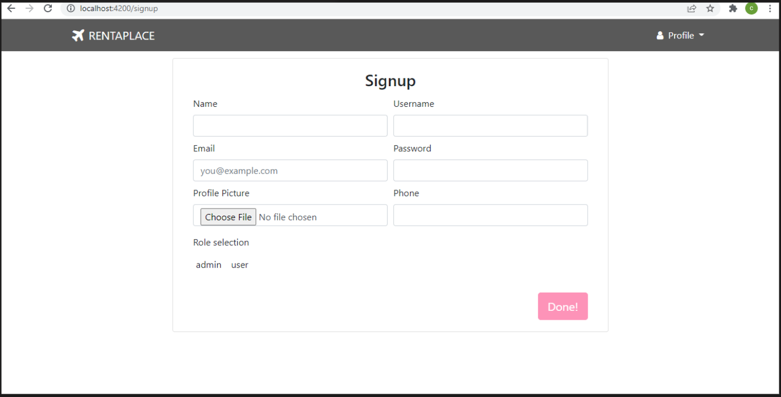
4. Demo
Register page:

Slide 9
4. Demo
Home page

Slide 10
Thank You.
PJ
Nguyen Viet Thang
Project of team 5
nguyen.thang@hcl.com

